Slide 1
Raytheon Preternship Project
By: Justin Pajak, Carter Goldman, and Patrick Creaven

Slide 2
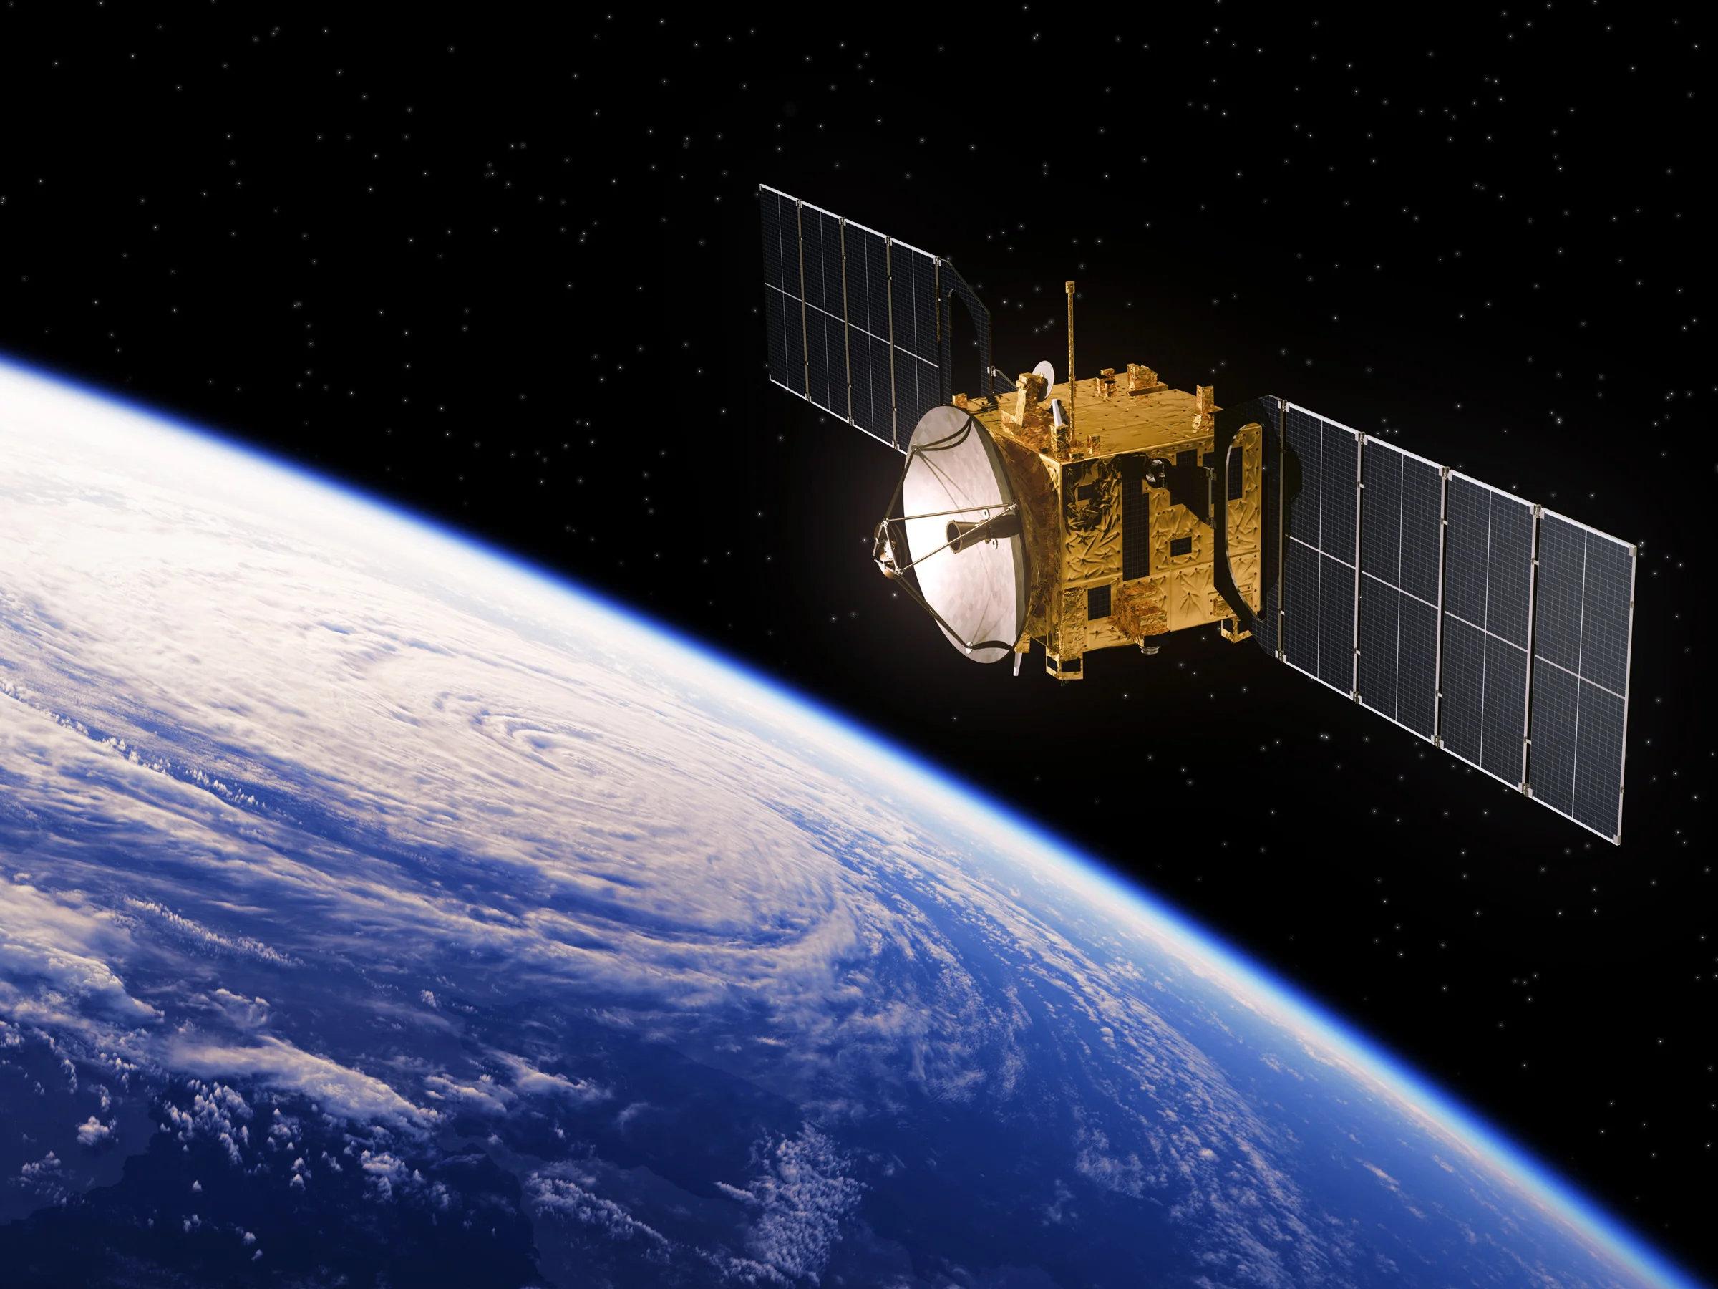
Project Overview
For our project, we designed a tool with C++ that:
Simulates the orbits of 24 hypothetical Low Earth Orbit (LEO) satellites in a circular orbit around the Earth in a constellation
Allows the user to input locations of ground stations
Allows the user to choose two ground stations, and calculates the path of shortest latency when communicating via the constellation

Slide 3
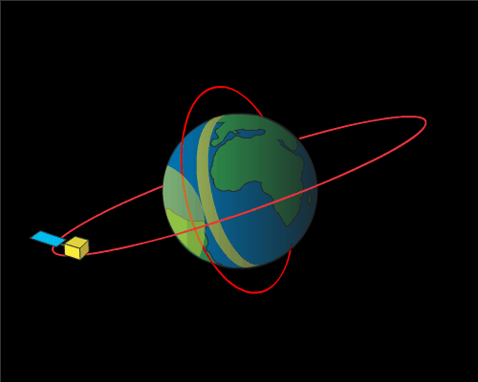
Design Plan - Initially
Gather real satellite data from a TLE file
Parse it and use that for satellite movements
Create a set number of ground stations and display shortest path between them while communicating across constellation

Slide 4
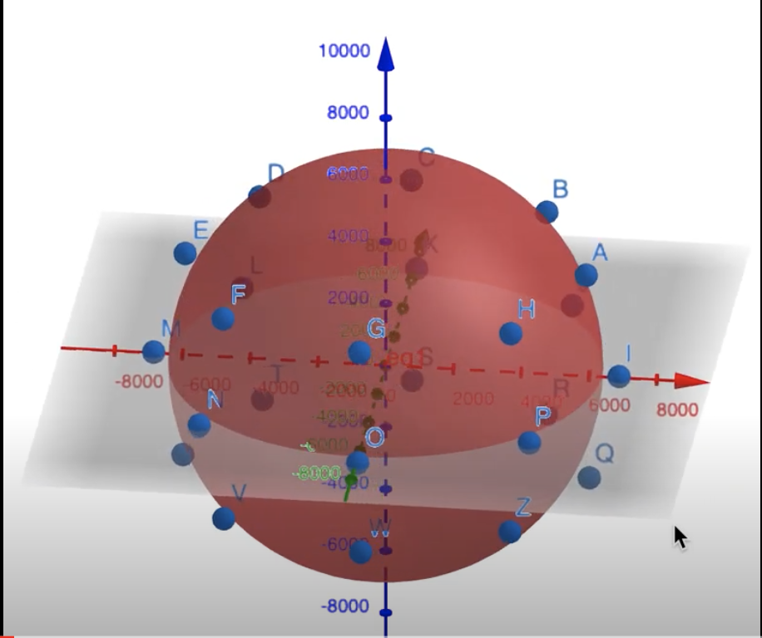
Design Plan - Ultimately
Couldn’t parse TLE file
Attempted to utilize external library for calculations
Had to abandon due to inability to download necessary packages on study machines
Created our own hypothetical circular satellites
Added small variations to make more realistic
Display dynamic satellite data
Create user interaction menu
User can input what ground stations they would like to connect to and from

Slide 5

Satellite Movements - Reimagined

Slide 6
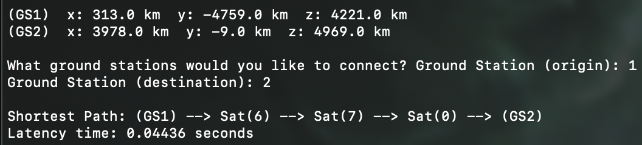
Final Project Description
Terminal shows locations of 24 satellites in orbit over time and their connections in the constellation
Prompts user to:
Continue simulation
Add new Ground Station
Calculate one-way latency time between two ground stations
Displays shortest path and shortest latency time

Slide 7
Object Oriented Programming
Created a Structure class
Ground Station and Satellite classes inherited from Structure
Made distance and latency calculation easier by having the same parent

Slide 8
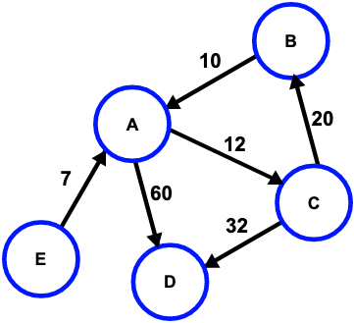
Data Structures Used - Graph
Used a graph to represent the constellation of satellites
Vertices = Satellites
Edges = Distance between satellites (km)
Useful to determine shortest distance between
two ground stations - Dijkstra’s Algorithm

Slide 9

Dynamic Array
List the vertices (Satellites) in the constellation
Dynamically change the amount of ground stations were established based on user input

Slide 10
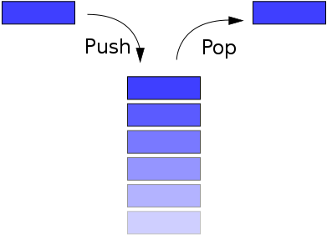
Stack and Singly Linked List
Used a Singly Linked List to develop a Stack data structure
Used the Stack to implement Dijkstra’s algorithm

Slide 11

How We Accomplished Our Goal
Used Github to manage our codebase
Utilized several data structures and algorithms to efficiently solve our problem
Utilized threading to create a more dynamic and complex user interaction
Set goals and alternatives each week to ensure our success

Slide 12
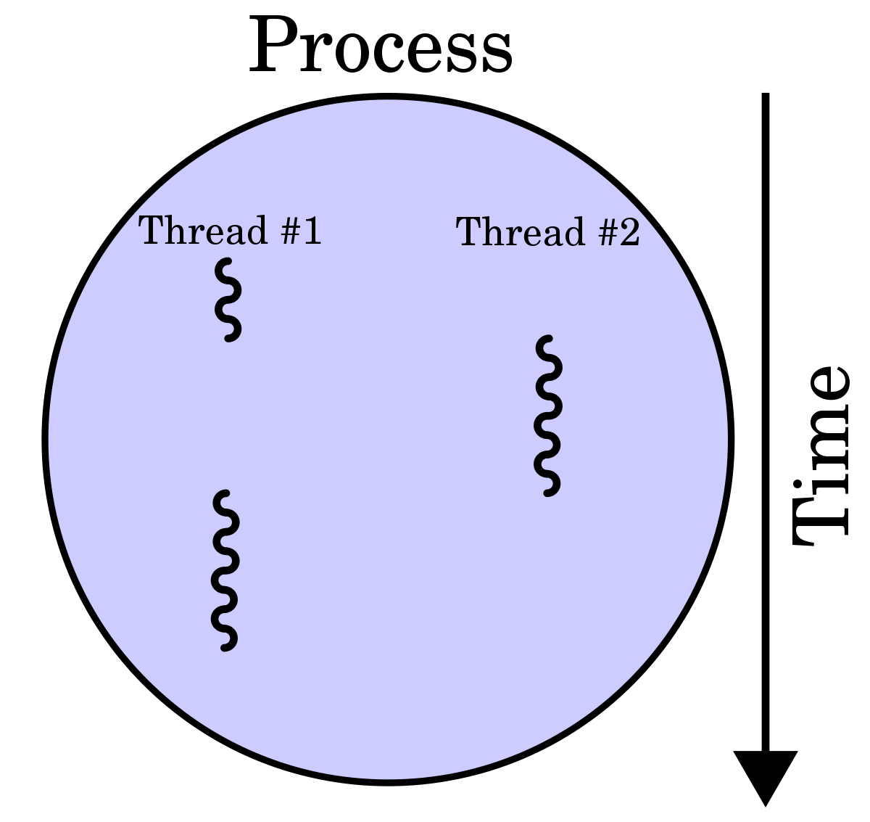
Threading...
Needed to allow for main thread to prompt user for input, while continuing calculations of the orbits in the background
Threading became the clear solution, placing the orbit calculation loop in its own thread, only pausing that performance when the correct input came from the main thread

Slide 13
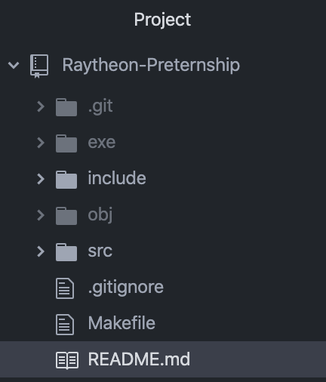
Code Demo

Slide 14
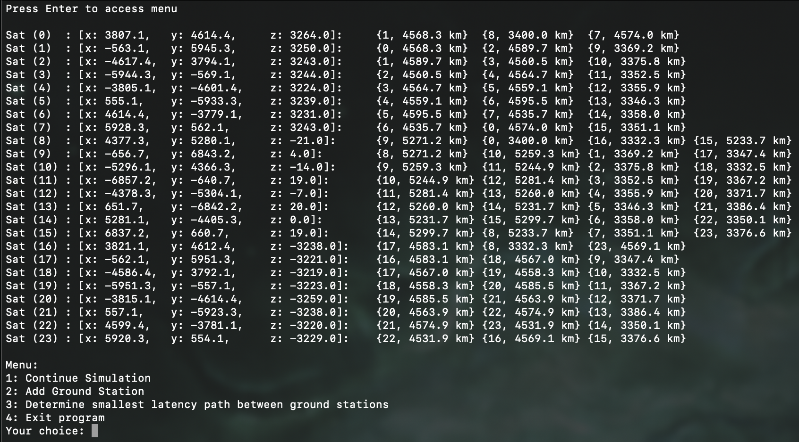
Final Project Demo

